Slide 1
Natural Language Processing
Lecture 6: Minimum Edit Distance

Slide 2
Minimum Edit Distance
Calculating the similarity between two strings is useful in many NLP tasks, such as spelling correction or co-reference resolution
The minimum edit distance between two strings is defined as the minimum number of editing operations
Insertion
Deletion
Substitution
Needed to transform one string into another

Slide 3
How similar are two strings?
Spell correction
The user typed “graffe”
Which is closest?
graf
graft
grail
giraffe
Computational Biology
Align two sequences of nucleotides
Resulting alignment:
AGGCTATCACCTGACCTCCAGGCCGATGCCC
TAGCTATCACGACCGCGGTCGATTTGCCCGAC
-AGGCTATCACCTGACCTCCAGGCCGA--TGCCC---
TAG-CTATCAC--GACCGC--GGTCGATTTGCCCGAC
Also for Machine Translation, Information Extraction, Speech Recognition

Slide 4

Minimum Edit Distance
Two strings and their alignment:

Slide 5
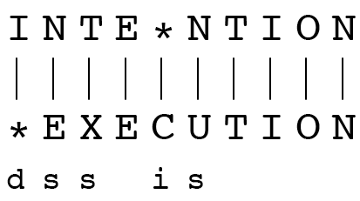
Minimum Edit Distance
If each operation has cost of 1
Distance between these is 5
If substitutions cost 2 (Levenshtein)
Distance between them is 8

Slide 6
Other uses of Edit Distance in NLP
Evaluating Machine Translation and speech recognition
R Spokesman confirms senior government adviser was shot
H Spokesman said the senior adviser was shot dead
S I D I
Named Entity Extraction and Entity Coreference
IBM Inc. announced today
IBM profits
Stanford President John Hennessy announced yesterday
for Stanford University President John Hennessy

Slide 7
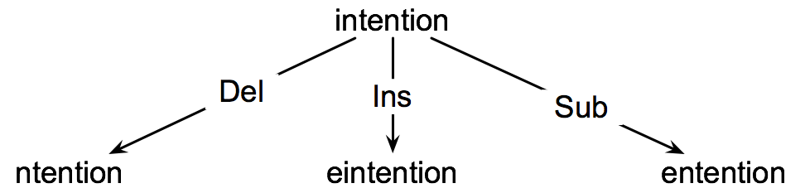
How to find the Min Edit Distance?
Searching for a path (sequence of edits) from the start string to the final string:
Initial state: the word we’re transforming
Operators: insert, delete, substitute
Goal state: the word we’re trying to get to
Path cost: what we want to minimize: the number of edits

Slide 8
Example
Kitten to Sitting
Kitten -> sitten (substitution)
Sitten -> sittin (substitution)
Sittin -> sitting (insertion)
Output: 3

Slide 9
Minimum Edit as Search
But the space of all edit sequences is huge!
We can’t afford to navigate naïvely
Lots of distinct paths wind up at the same state.
We don’t have to keep track of all of them
Just the shortest path to each of those revisted states.

Slide 10
Defining Min Edit Distance
For two strings
X of length n
Y of length m
We define D(i,j)
the edit distance between X[1..i] and Y[1..j]
i.e., the first i characters of X and the first j characters of Y
The edit distance between X and Y is thus D(n,m)

Slide 11
Dynamic Programming for Minimum Edit Distance
Dynamic programming: A tabular computation of D(n,m)
Solving problems by combining solutions to sub-problems.
Bottom-up
We compute D(i,j) for small i,j
And compute larger D(i,j) based on previously computed smaller values
i.e., compute D(i,j) for all i (0 < i < n) and j (0 < j < m)

Slide 12
Defining Min Edit Distance (Levenshtein)
Initialization
D(i,0) = i cost of i deletion
D(0,j) = j cost of j insertion
Recurrence Relation:
For each i = 1…M
For each j = 1…N
D(i-1,j) + 1 deletion cost
D(i,j)= min D(i,j-1) + 1 insertion cost
D(i-1,j-1) +2; if X(i) ≠ Y(j)
0; if X(i) = Y(j)
Termination:
D(N,M) is distance

Slide 13
The Edit Distance Table
N
O
I
T
N
E
T
N
I
#
 | # | E | X | E | C | U | T | I | O | N

Slide 14
The Edit Distance Table
N
O
I
T
N
E
T
N
I
# | 0
 | # | E | X | E | C | U | T | I | O | N

Slide 15
The Edit Distance Table
N
O
I
T
N
E
T
N
I
# | 0 | 1
 | # | E | X | E | C | U | T | I | O | N

Slide 16
The Edit Distance Table
N
O
I
T
N
E
T
N
I
# | 0 | 1 | 2
 | # | E | X | E | C | U | T | I | O | N

Slide 17
The Edit Distance Table
N
O
I
T
N
E
T
N
I
# | 0 | 1 | 2 | 3
 | # | E | X | E | C | U | T | I | O | N

Slide 18
The Edit Distance Table
N
O
I
T
N
E
T
N
I
# | 0 | 1 | 2 | 3 | 4 | 5 | 6 | 7 | 8 | 9
 | # | E | X | E | C | U | T | I | O | N

Slide 19
The Edit Distance Table
N
O
I
T
N
E
T
N
I | 1
# | 0 | 1 | 2 | 3 | 4 | 5 | 6 | 7 | 8 | 9
 | # | E | X | E | C | U | T | I | O | N

Slide 20
The Edit Distance Table
N
O
I
T
N
E
T
N
I | 1
# | 0 | 1 | 2 | 3 | 4 | 5 | 6 | 7 | 8 | 9
 | # | E | X | E | C | U | T | I | O | N

Slide 21
The Edit Distance Table
N
O
I
T
N
E
T
N | 2
I | 1
# | 0 | 1 | 2 | 3 | 4 | 5 | 6 | 7 | 8 | 9
 | # | E | X | E | C | U | T | I | O | N

Slide 22
The Edit Distance Table
N | 9
O | 8
I | 7
T | 6
N | 5
E | 4
T | 3
N | 2
I | 1
# | 0 | 1 | 2 | 3 | 4 | 5 | 6 | 7 | 8 | 9
 | # | E | X | E | C | U | T | I | O | N

Slide 23
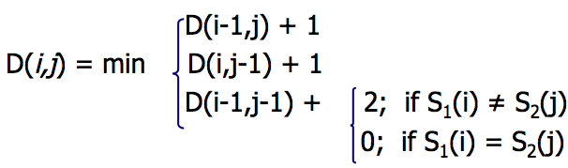
The Edit Distance Table
N | 9
O | 8
I | 7
T | 6
N | 5
E | 4
T | 3
N | 2
I | 1
# | 0 | 1 | 2 | 3 | 4 | 5 | 6 | 7 | 8 | 9
 | # | E | X | E | C | U | T | I | O | N

Slide 24
Edit Distance
N | 9
O | 8
I | 7
T | 6
N | 5
E | 4
T | 3
N | 2
I | 1
# | 0 | 1 | 2 | 3 | 4 | 5 | 6 | 7 | 8 | 9
 | # | E | X | E | C | U | T | I | O | N

Slide 25
The Edit Distance Table
N | 9
O | 8
I | 7
T | 6
N | 5
E | 4
T | 3
N | 2
I | 1 | 2
# | 0 | 1 | 2 | 3 | 4 | 5 | 6 | 7 | 8 | 9
 | # | E | X | E | C | U | T | I | O | N

Slide 26
The Edit Distance Table
N | 9
O | 8
I | 7
T | 6
N | 5
E | 4
T | 3
N | 2
I | 1 | 2 | 3
# | 0 | 1 | 2 | 3 | 4 | 5 | 6 | 7 | 8 | 9
 | # | E | X | E | C | U | T | I | O | N

Slide 27
The Edit Distance Table
N | 9
O | 8
I | 7
T | 6
N | 5
E | 4
T | 3
N | 2
I | 1 | 2 | 3
# | 0 | 1 | 2 | 3 | 4 | 5 | 6 | 7 | 8 | 9
 | # | E | X | E | C | U | T | I | O | N

Slide 28
The Edit Distance Table
N | 9
O | 8
I | 7
T | 6
N | 5
E | 4
T | 3
N | 2
I | 1 | 2 | 3 | 4
# | 0 | 1 | 2 | 3 | 4 | 5 | 6 | 7 | 8 | 9
 | # | E | X | E | C | U | T | I | O | N

Slide 29
The Edit Distance Table
N | 9
O | 8
I | 7
T | 6
N | 5
E | 4
T | 3
N | 2
I | 1 | 2 | 3 | 4 | 5
# | 0 | 1 | 2 | 3 | 4 | 5 | 6 | 7 | 8 | 9
 | # | E | X | E | C | U | T | I | O | N

Slide 30
The Edit Distance Table
N | 9
O | 8
I | 7
T | 6
N | 5
E | 4
T | 3
N | 2
I | 1 | 2 | 3 | 4 | 5 | 6
# | 0 | 1 | 2 | 3 | 4 | 5 | 6 | 7 | 8 | 9
 | # | E | X | E | C | U | T | I | O | N

Slide 31
The Edit Distance Table
N | 9
O | 8
I | 7
T | 6
N | 5
E | 4
T | 3
N | 2
I | 1 | 2 | 3 | 4 | 5 | 6 | 7
# | 0 | 1 | 2 | 3 | 4 | 5 | 6 | 7 | 8 | 9
 | # | E | X | E | C | U | T | I | O | N

Slide 32
The Edit Distance Table
N | 9
O | 8
I | 7
T | 6
N | 5
E | 4
T | 3
N | 2
I | 1 | 2 | 3 | 4 | 5 | 6 | 7 | 6
# | 0 | 1 | 2 | 3 | 4 | 5 | 6 | 7 | 8 | 9
 | # | E | X | E | C | U | T | I | O | N

Slide 33
The Edit Distance Table
N | 9
O | 8
I | 7
T | 6
N | 5
E | 4
T | 3
N | 2
I | 1 | 2 | 3 | 4 | 5 | 6 | 7 | 6 | 7
# | 0 | 1 | 2 | 3 | 4 | 5 | 6 | 7 | 8 | 9
 | # | E | X | E | C | U | T | I | O | N

Slide 34
The Edit Distance Table
N | 9
O | 8
I | 7
T | 6
N | 5
E | 4
T | 3
N | 2
I | 1 | 2 | 3 | 4 | 5 | 6 | 7 | 6 | 7 | 8
# | 0 | 1 | 2 | 3 | 4 | 5 | 6 | 7 | 8 | 9
 | # | E | X | E | C | U | T | I | O | N

Slide 35
The Edit Distance Table
N | 9
O | 8
I | 7
T | 6
N | 5
E | 4
T | 3
N | 2 | 3
I | 1 | 2 | 3 | 4 | 5 | 6 | 7 | 6 | 7 | 8
# | 0 | 1 | 2 | 3 | 4 | 5 | 6 | 7 | 8 | 9
 | # | E | X | E | C | U | T | I | O | N

Slide 36
The Edit Distance Table
N | 9
O | 8
I | 7
T | 6
N | 5
E | 4
T | 3
N | 2 | 3 | 4
I | 1 | 2 | 3 | 4 | 5 | 6 | 7 | 6 | 7 | 8
# | 0 | 1 | 2 | 3 | 4 | 5 | 6 | 7 | 8 | 9
 | # | E | X | E | C | U | T | I | O | N

Slide 37
The Edit Distance Table
N | 9
O | 8
I | 7
T | 6
N | 5
E | 4
T | 3
N | 2 | 3 | 4 | 5 | 6 | 7 | 8 | 7 | 8 | 7
I | 1 | 2 | 3 | 4 | 5 | 6 | 7 | 6 | 7 | 8
# | 0 | 1 | 2 | 3 | 4 | 5 | 6 | 7 | 8 | 9
 | # | E | X | E | C | U | T | I | O | N

Slide 38
The Edit Distance Table
N | 9 | 8 | 9 | 10 | 11 | 12 | 11 | 10 | 9 | 8
O | 8 | 7 | 8 | 9 | 10 | 11 | 10 | 9 | 8 | 9
I | 7 | 6 | 7 | 8 | 9 | 10 | 9 | 8 | 9 | 10
T | 6 | 5 | 6 | 7 | 8 | 9 | 8 | 9 | 10 | 11
N | 5 | 4 | 5 | 6 | 7 | 8 | 9 | 10 | 11 | 10
E | 4 | 3 | 4 | 5 | 6 | 7 | 8 | 9 | 10 | 9
T | 3 | 4 | 5 | 6 | 7 | 8 | 7 | 8 | 9 | 8
N | 2 | 3 | 4 | 5 | 6 | 7 | 8 | 7 | 8 | 7
I | 1 | 2 | 3 | 4 | 5 | 6 | 7 | 6 | 7 | 8
# | 0 | 1 | 2 | 3 | 4 | 5 | 6 | 7 | 8 | 9
 | # | E | X | E | C | U | T | I | O | N

Slide 39
فرح
فرخ

Slide 40
Computing alignments
Edit distance isn’t sufficient
We often need to align each character of the two strings to each other
We do this by keeping a “backtrace”
Every time we enter a cell, remember where we came from
When we reach the end,
Trace back the path from the upper right corner to read off the alignment

Slide 41
Edit Distance
N | 9
O | 8
I | 7
T | 6
N | 5
E | 4
T | 3
N | 2
I | 1
# | 0 | 1 | 2 | 3 | 4 | 5 | 6 | 7 | 8 | 9
 | # | E | X | E | C | U | T | I | O | N

Slide 42
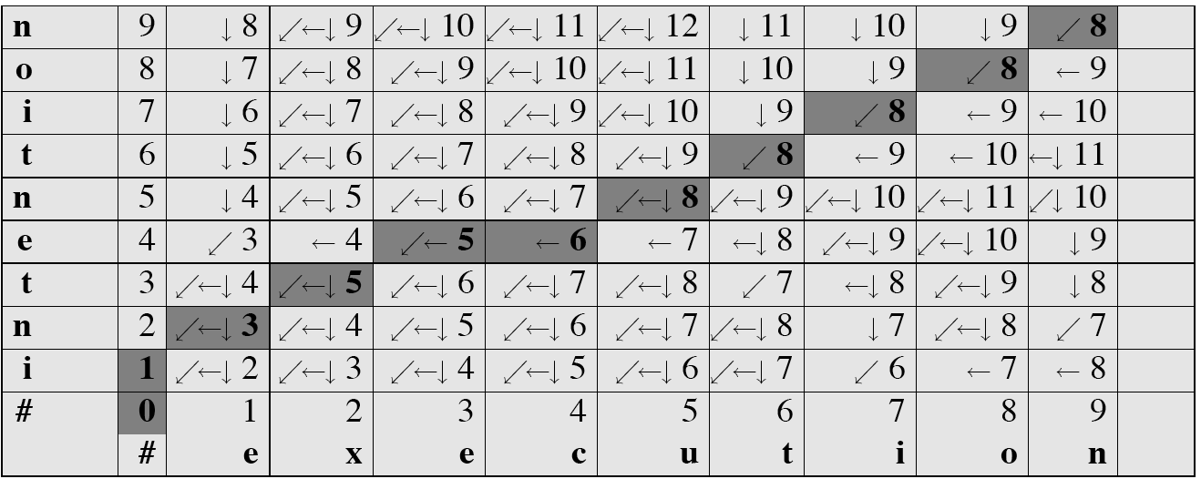
MinEdit with Backtrace

Slide 43
Adding Backtrace to Minimum Edit Distance
Base conditions: Termination:
D(i,0) = i D(0,j) = j D(N,M) is distance
Recurrence Relation:
For each i = 1…M
For each j = 1…N
D(i-1,j) + 1
D(i,j)= min D(i,j-1) + 1
D(i-1,j-1) + 2; if X(i) ≠ Y(j)
0; if X(i) = Y(j)
LEFT
ptr(i,j)=
DOWN
DIAG
deletion
insertion
substitution
insertion
deletion
substitution

Slide 44
The Distance Matrix
Every non-decreasing path
from (0,0) to (M, N)
corresponds to
an alignment
of the two sequences
x₀ …………………… x_{N}
An optimal alignment is composed of optimal subalignments
y₀ ……………………………… y_{M}

Slide 45
Result of Backtrace
Two strings and their alignment:

Slide 46
Performance
Time: O(nm)
Space: O(nm)
Backtrace O(n+m)

Slide 47
MINIMUM EDIT DISTANCE
Weighted Minimum Edit Distance

Slide 48
Weighted Edit Distance
Why would we add weights to the computation?
Spell Correction: some letters are more likely to be mistyped than others
Biology: certain kinds of deletions or insertions are more likely than others

Slide 49
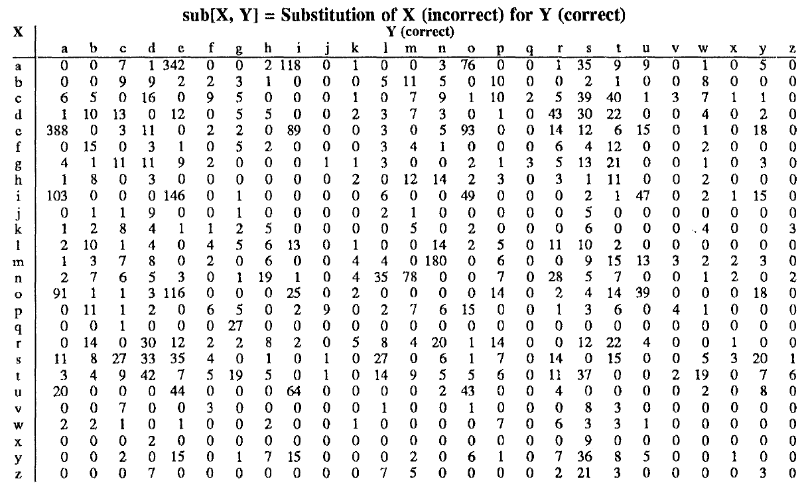
Confusion matrix for spelling errors

Slide 50
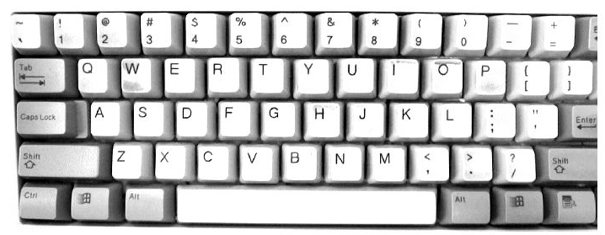

Slide 51
Weighted Min Edit Distance
Initialization:
D(0,0) = 0
D(i,0) = D(i-1,0) + del[x(i)]; 1 < i ≤ N
D(0,j) = D(0,j-1) + ins[y(j)]; 1 < j ≤ M
Recurrence Relation:
D(i-1,j) + del[x(i)]
D(i,j)= min D(i,j-1) + ins[y(j)]
D(i-1,j-1)+sub[x(i),y(j)]
Termination:
D(N,M) is distance

Slide 52
Spelling Problems
Detectng isolated non-words
“grafe” “exampel”
Fixing isolated non-words
“grafe” -> “giraffe” , “exampel” ->“example”
Fixing errors in context
“I ate desert” -> “I ate dessert”
“It was written be me” -> “It was written by me”
اسلم نے سیب کھائی <- اسلم نے سیب کھایا

Slide 53
How to choose between options
Probabilities of edits
Insertions, deletions, substitutions
Transpositions
Probability of the new word

Slide 54
Pakistan
LHE
P A K I S T A N
* * * * * * * L H E

Slide 55
Revision
Probability: p(X = x)
Conditional Probability: p(X = x , Y = y)
Independence
Chain Rule
Joined Probability: p(X = x | Y = y)

